Slide 1
Graduate Artificial Intelligence CS 640 Introduction
Jeffrey Considine
jconsidi@bu.edu

Slide 2
Plan for Today
What is AI?
Turing Test
AI Definitions
Artificial General Intelligence and AI Successes
Course logistics

Slide 3
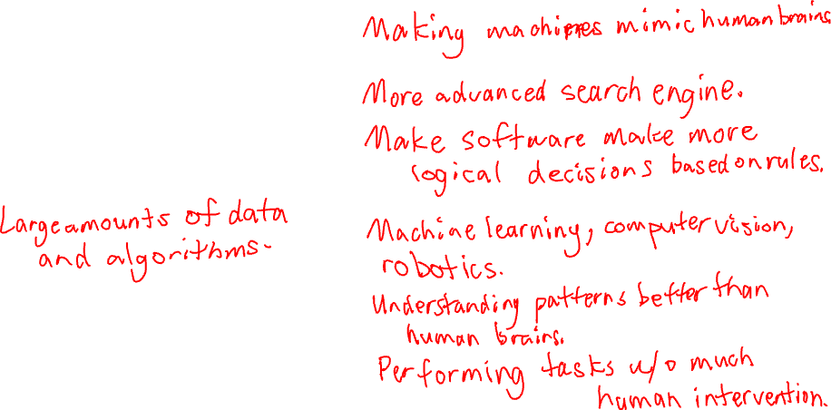
What is AI?
???

Slide 4
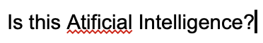
Is this AI?
Google Docs and most modern word processors…

Slide 5
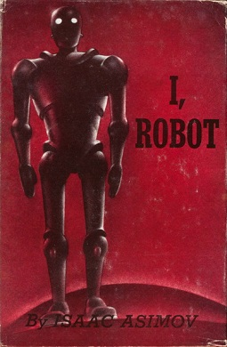
Is this AI?
I, Robot (1950)
By Isaac Asimov
Image via https://en.wikipedia.org/wiki/I,_Robot

Slide 6
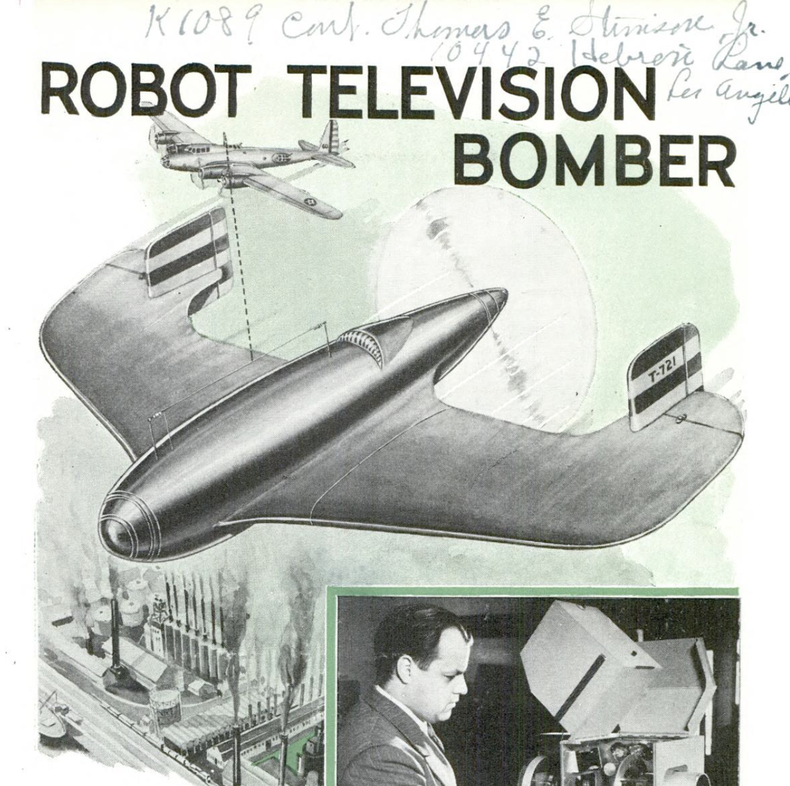
Is this AI?
Robot Television Bomber (1940)

Slide 7
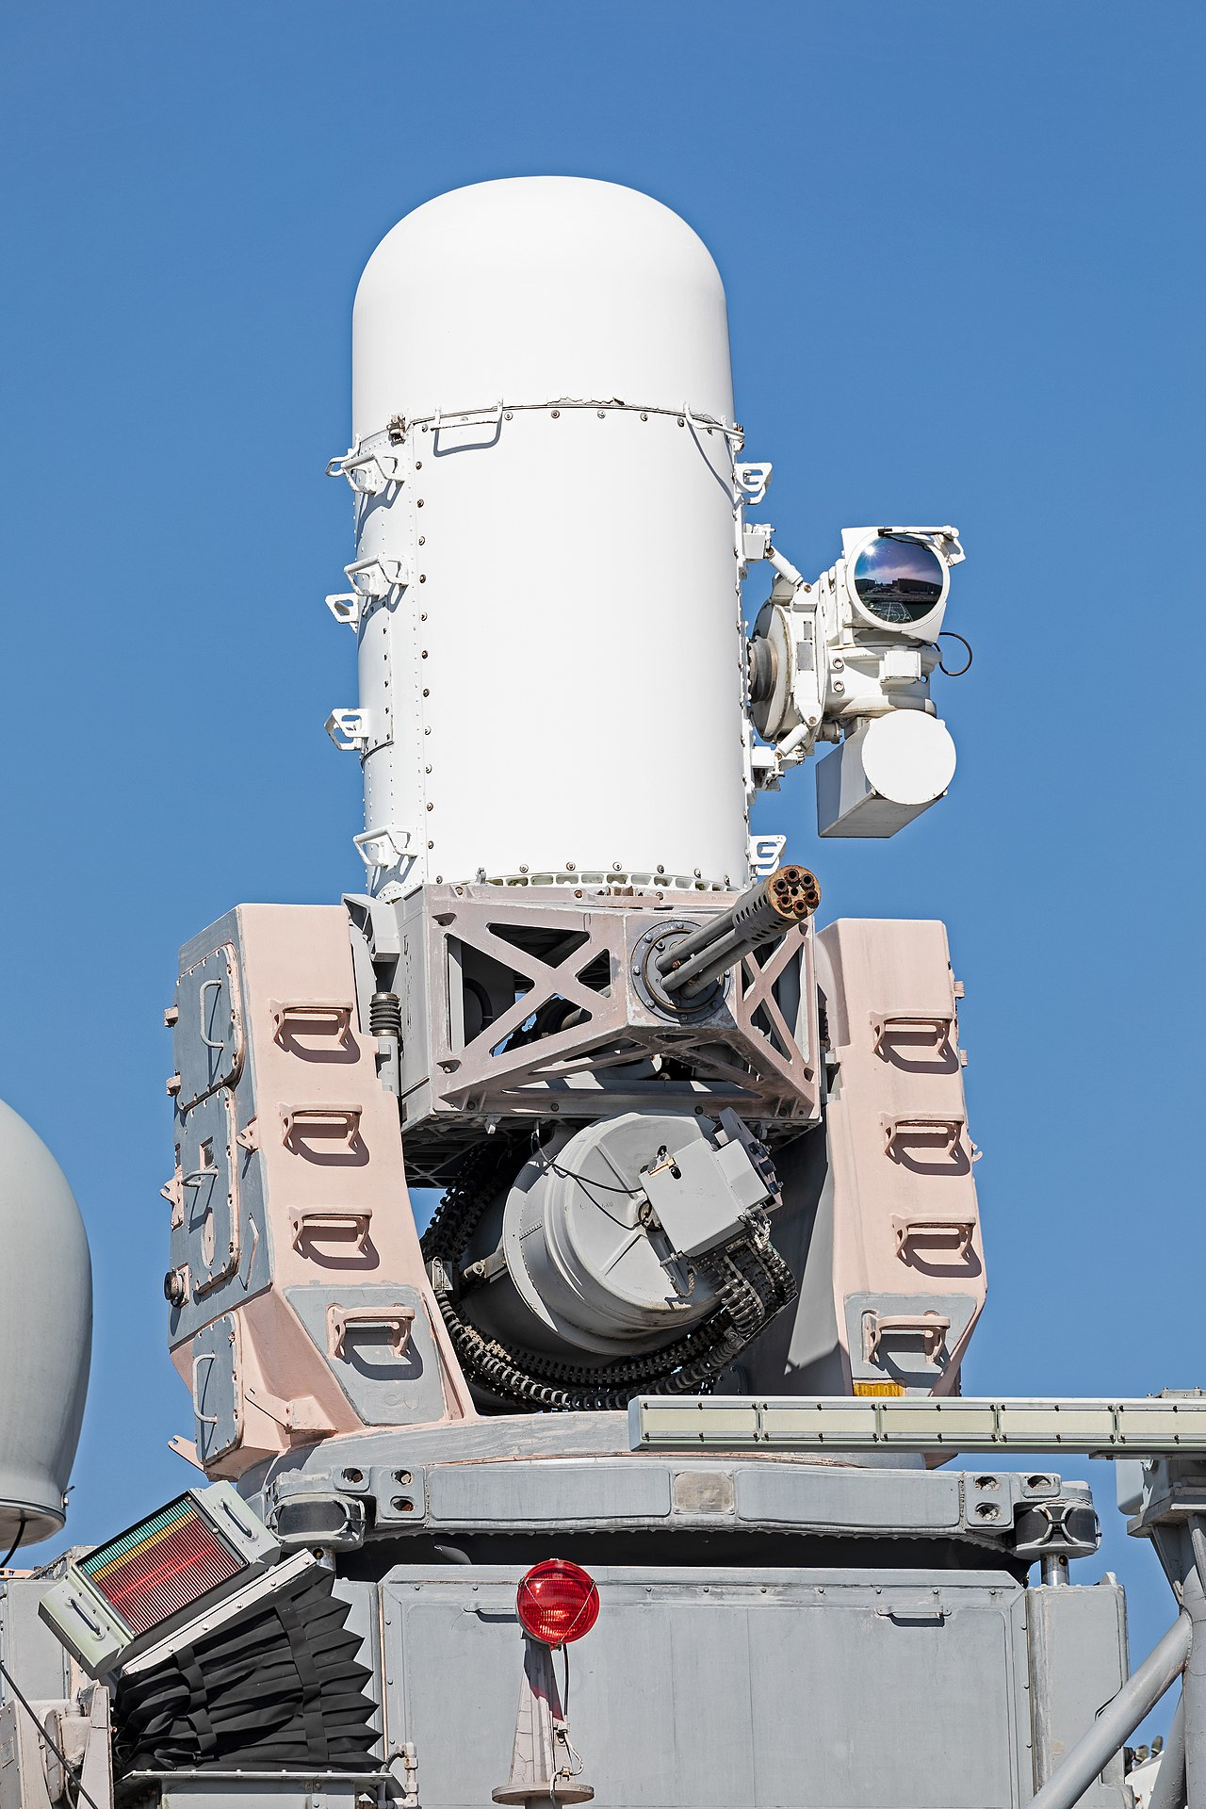
Is this AI?
Phalanx Close-In Weapon System (1973)
https://en.wikipedia.org/wiki/Phalanx_CIWS

Slide 8
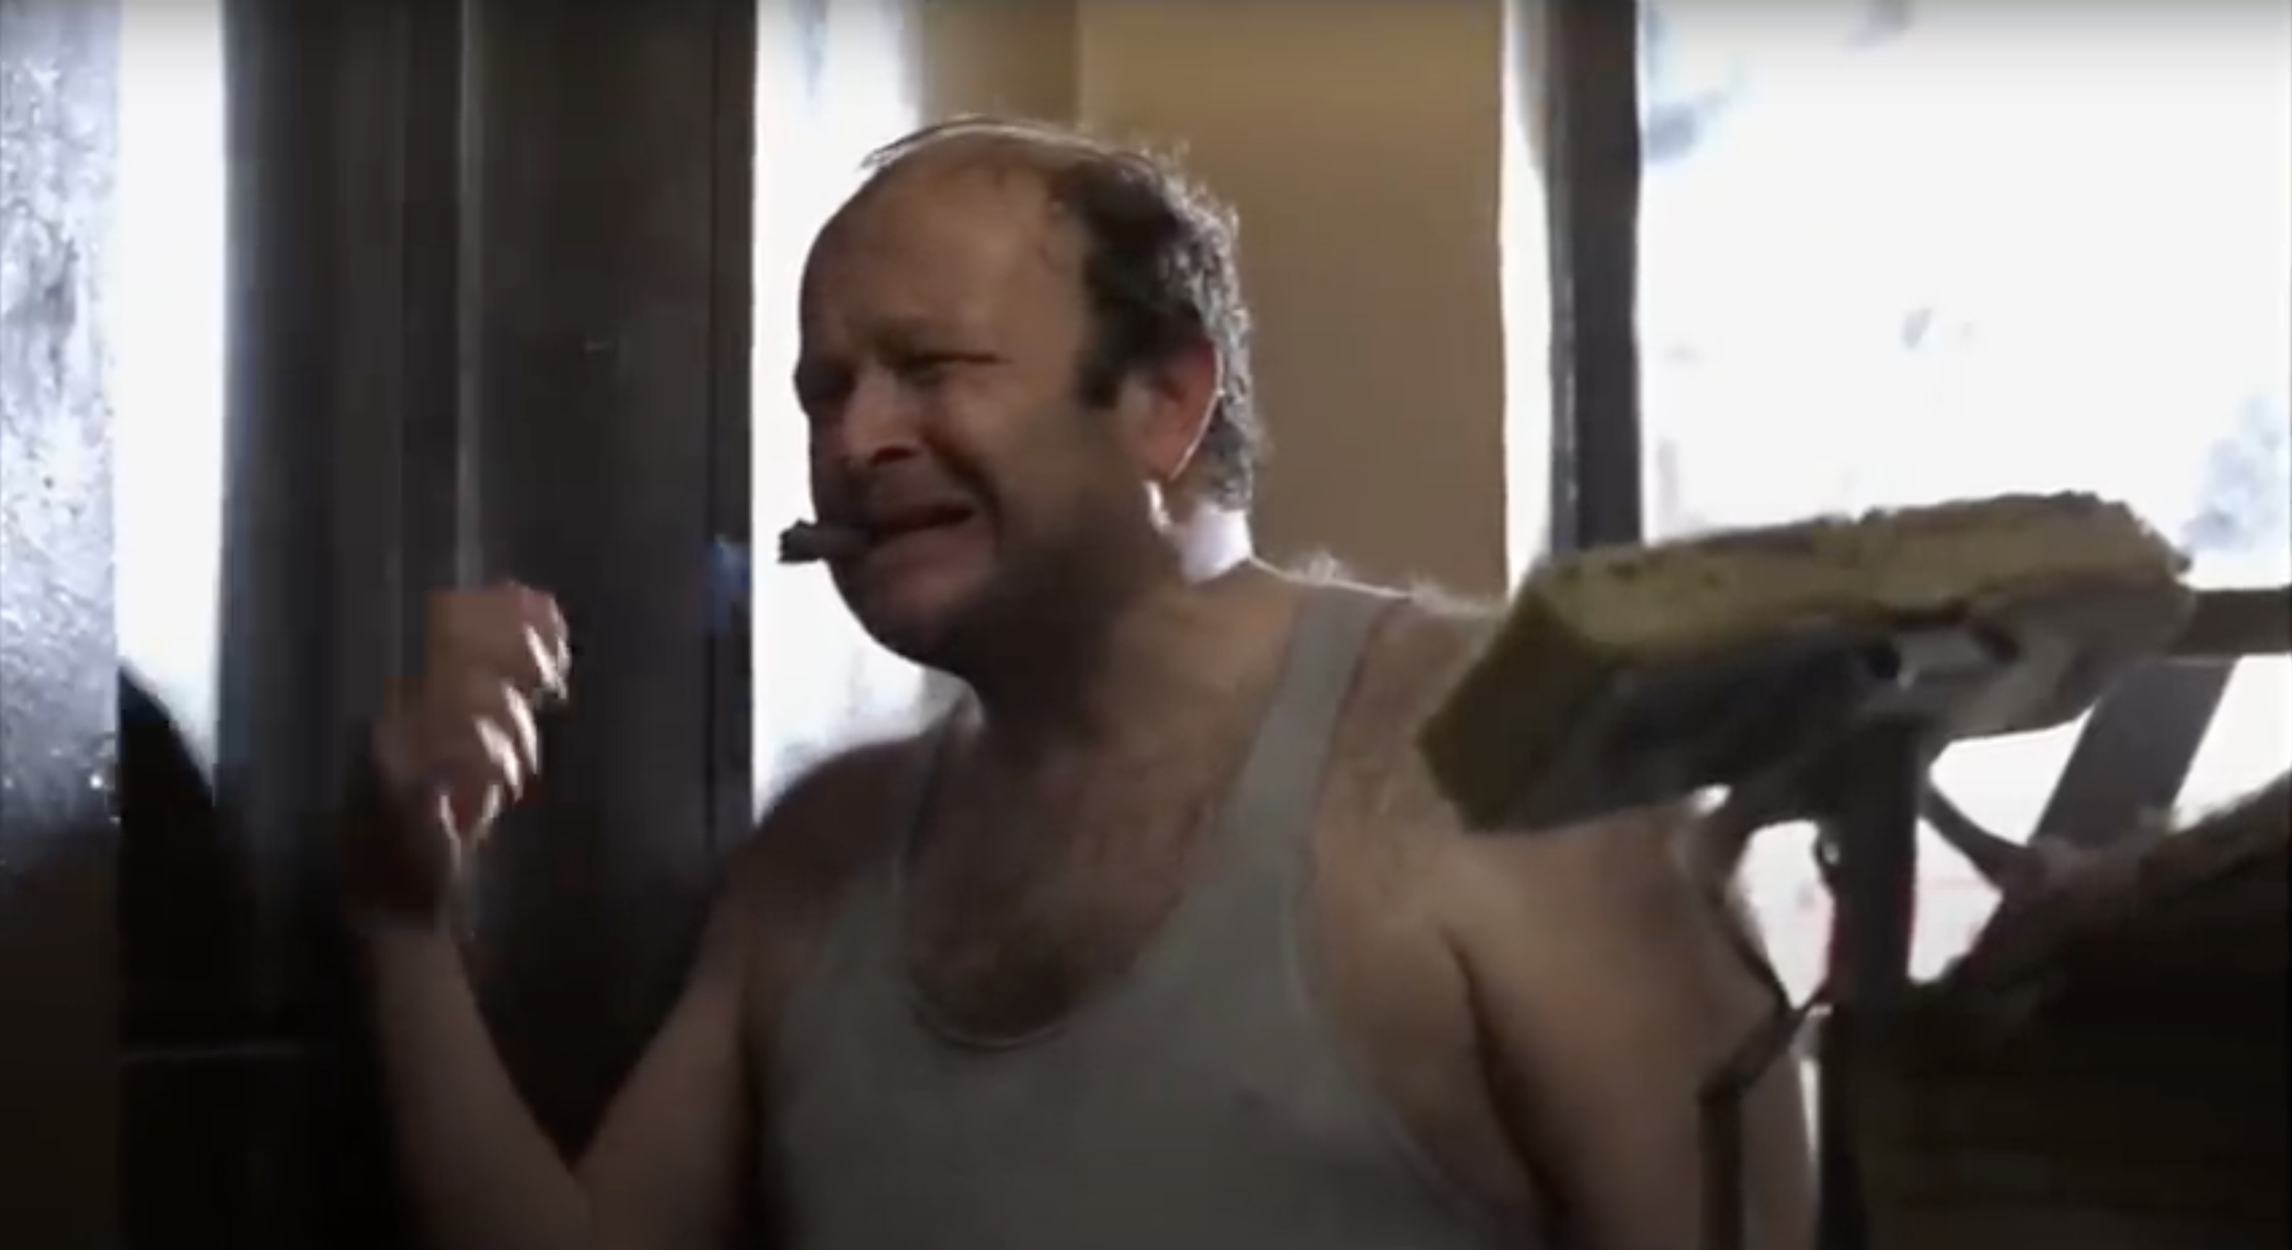
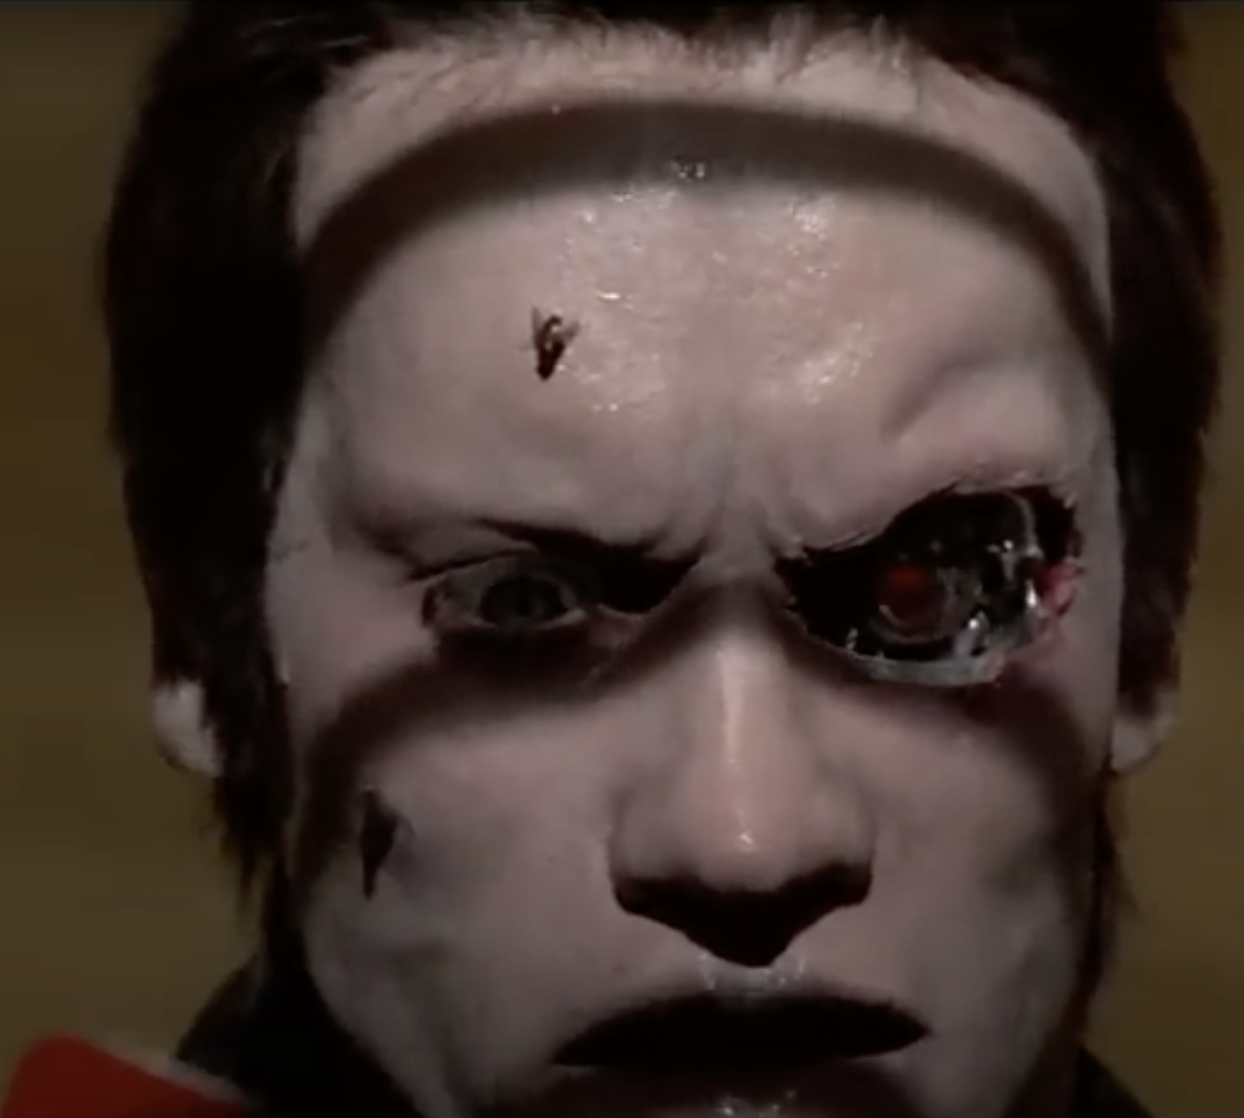
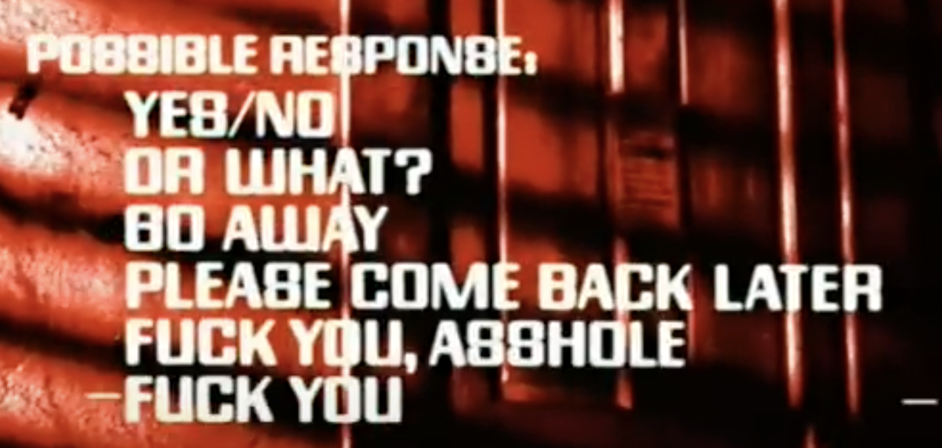
Is this AI?
Prompt: Hey buddy, you got a dead cat in there, or what?
Terminator (1984)
Image source: https://www.youtube.com/watch?v=zlJtohZSsfY&rco=1

Slide 9
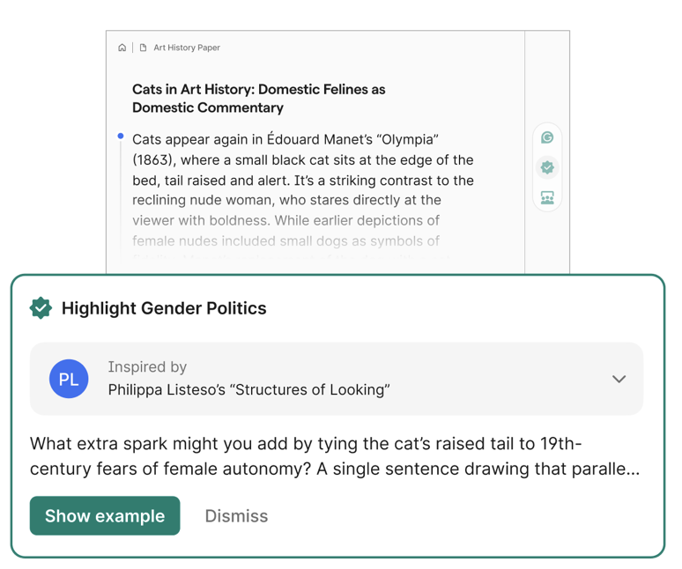
Is this AI?
Grammarly (2009)
https://www.grammarly.com/ai-agents/expert-review

Slide 10
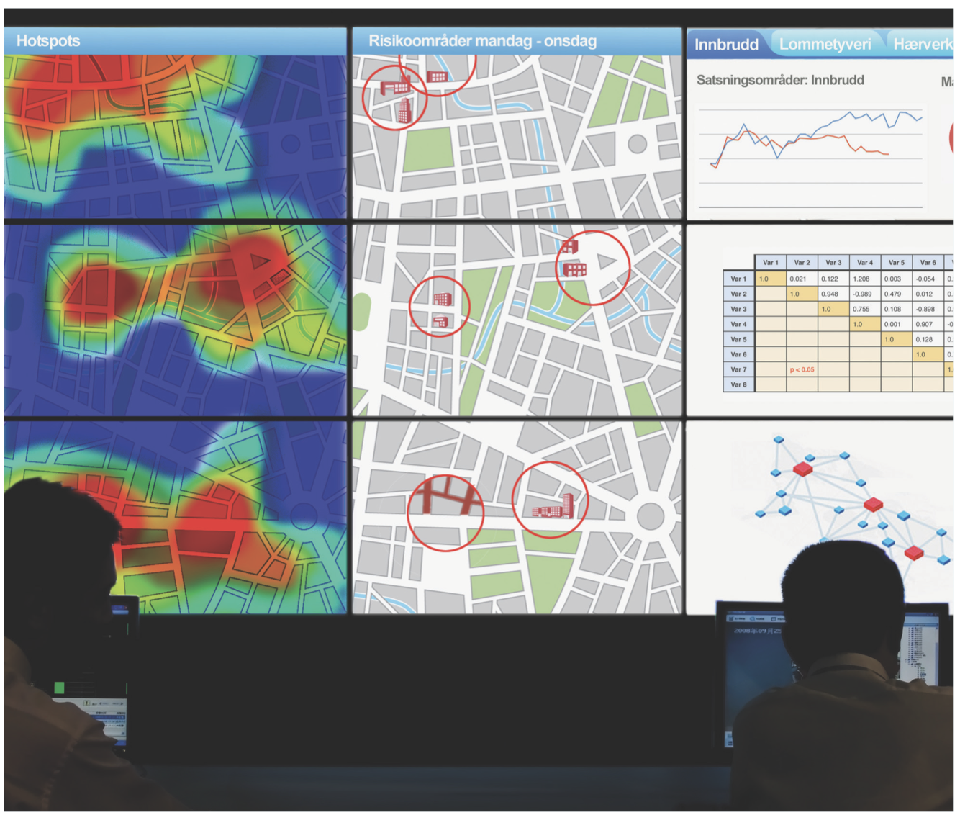
Is this AI?
It’s Not the Algorithm, It’s the Data (2017)
https://dl.acm.org/doi/pdf/10.1145/3022181

Slide 11
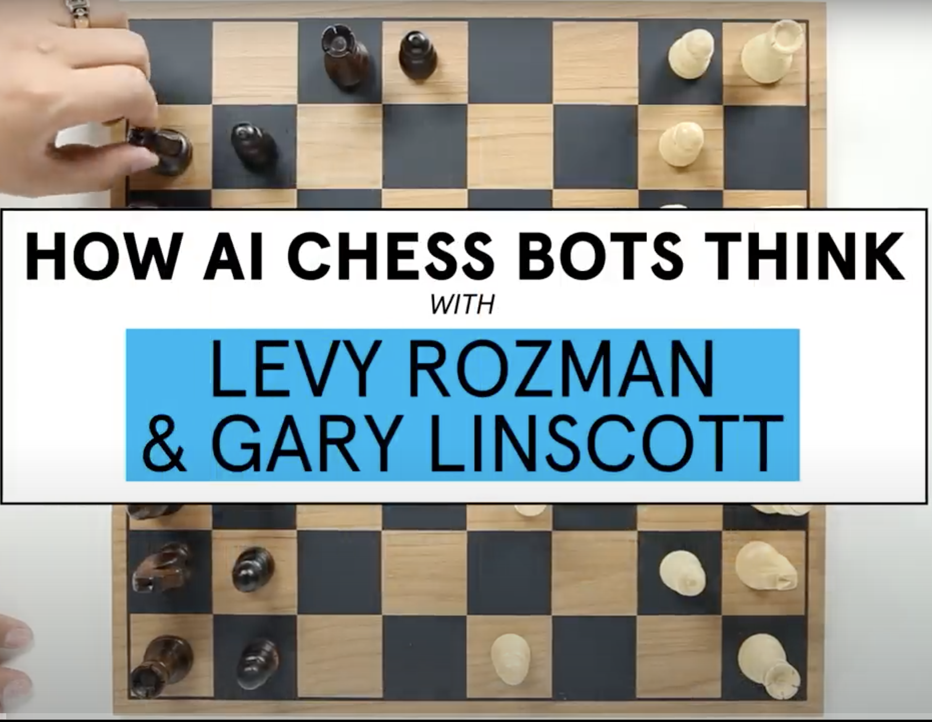
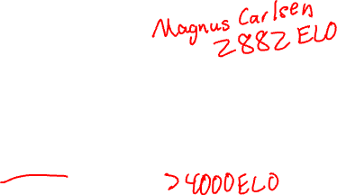
Is this AI?
AlphaZero (2017), StockFish, Leela Chess Zero…
Why AI Chess Bots Are Virtually Unbeatable (ft. GothamChess) | WIRED
Notes:
Magnus Carlsen peak rating 2882 (according to Wikipedia 2025-08-31). Stockfish often quoted as >4000.

Slide 12
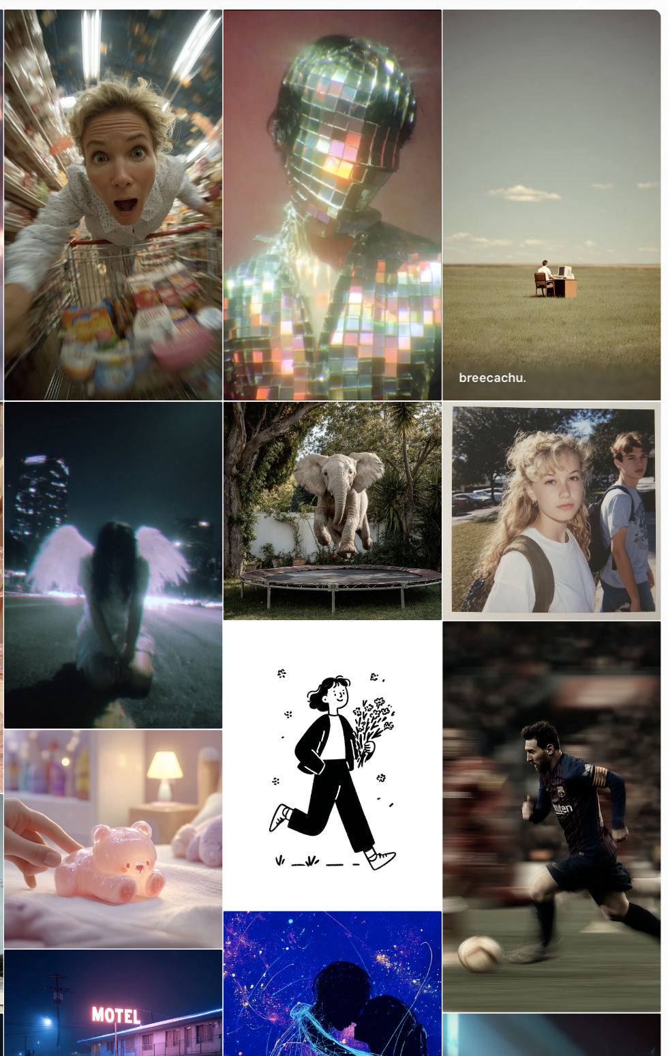
Is this AI?
Midjourney (2022)
https://www.midjourney.com/explore

Slide 13
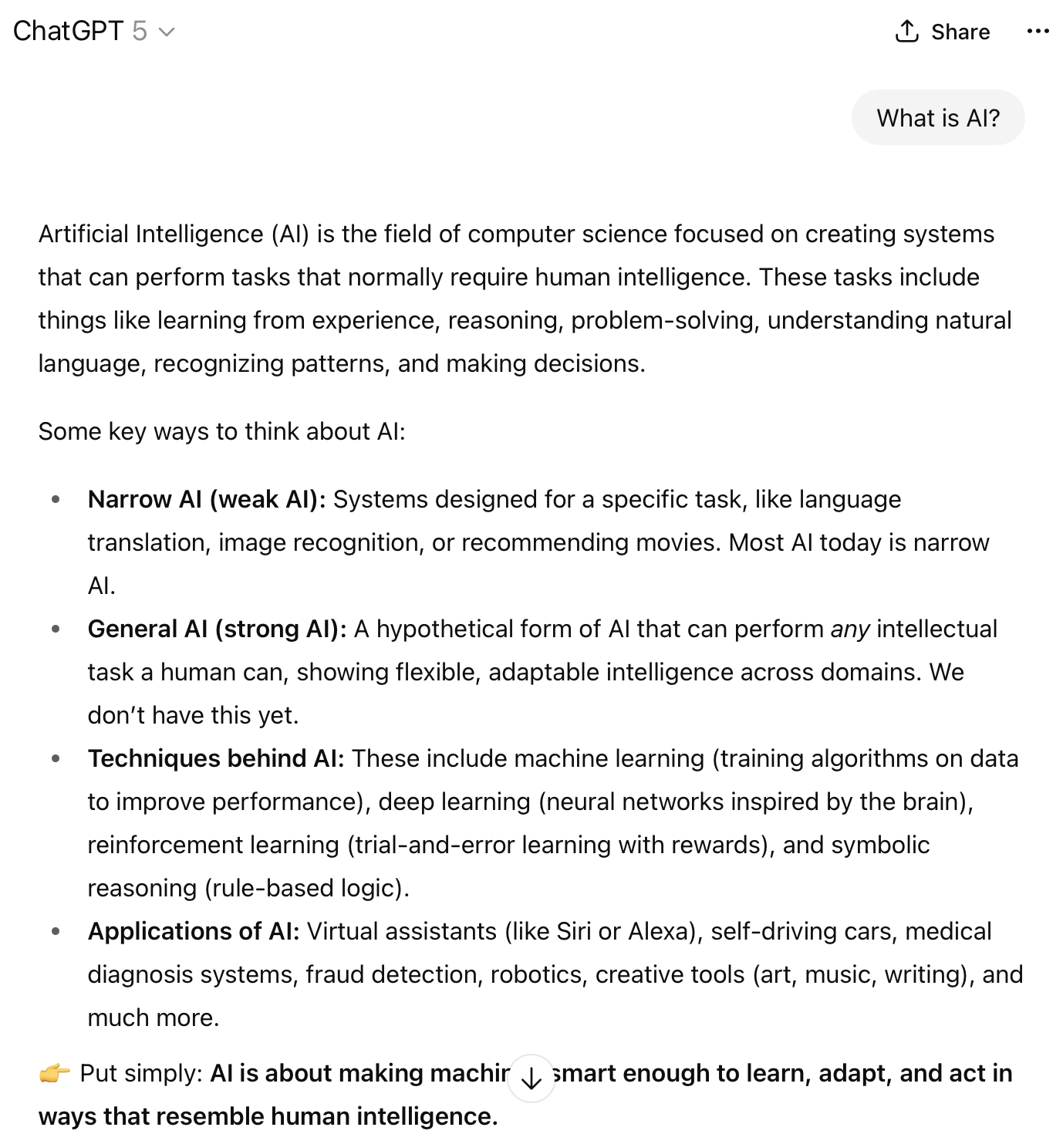
Is this AI?
ChatGPT (2022)
https://chatgpt.com/share/68b49f0e-8df4-800c-bdd7-515a628470d3

Slide 14
AI Effect
“Every time we figure out a piece of it, it stops being magical; we say, 'Oh, that's just a computation.”
-- Rodney Brooks

Slide 15
Any questions?

Slide 16
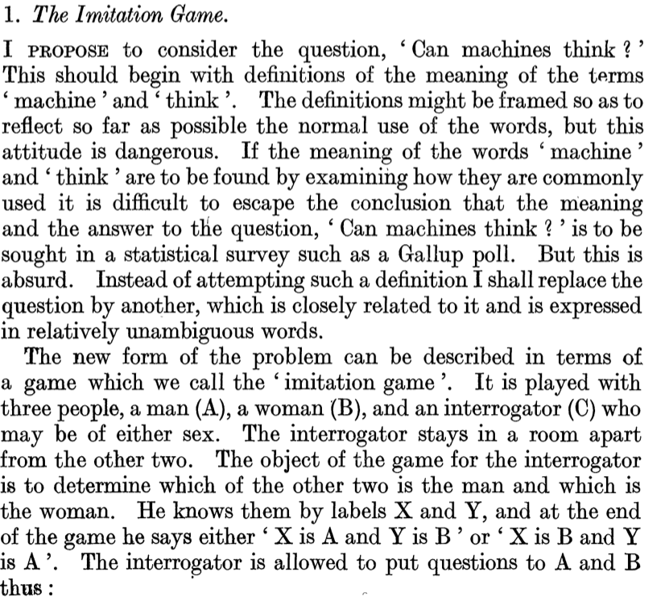
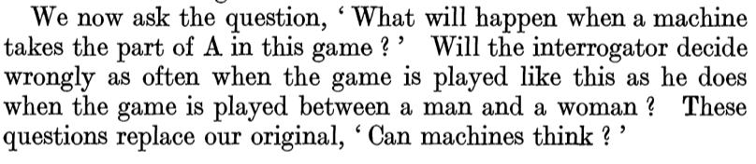

Turing Test (1950)
Computing Machinery and Intelligence (1950)
…

Slide 17
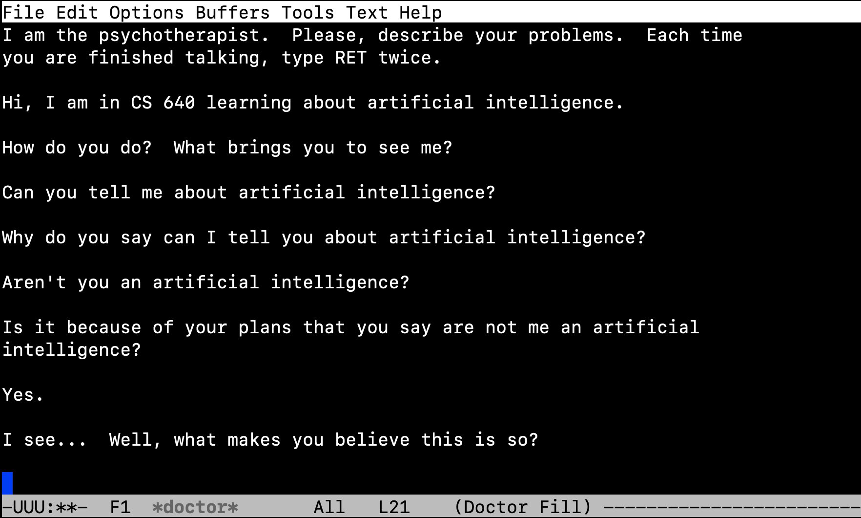
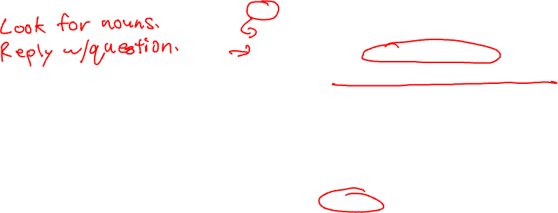
Eliza Chatbot (1964-1967)
Original version developed from 1964 to 1967 by Joseph Weizenbaum.
Screenshot from Emacs implementation via M-x doctor

Slide 18
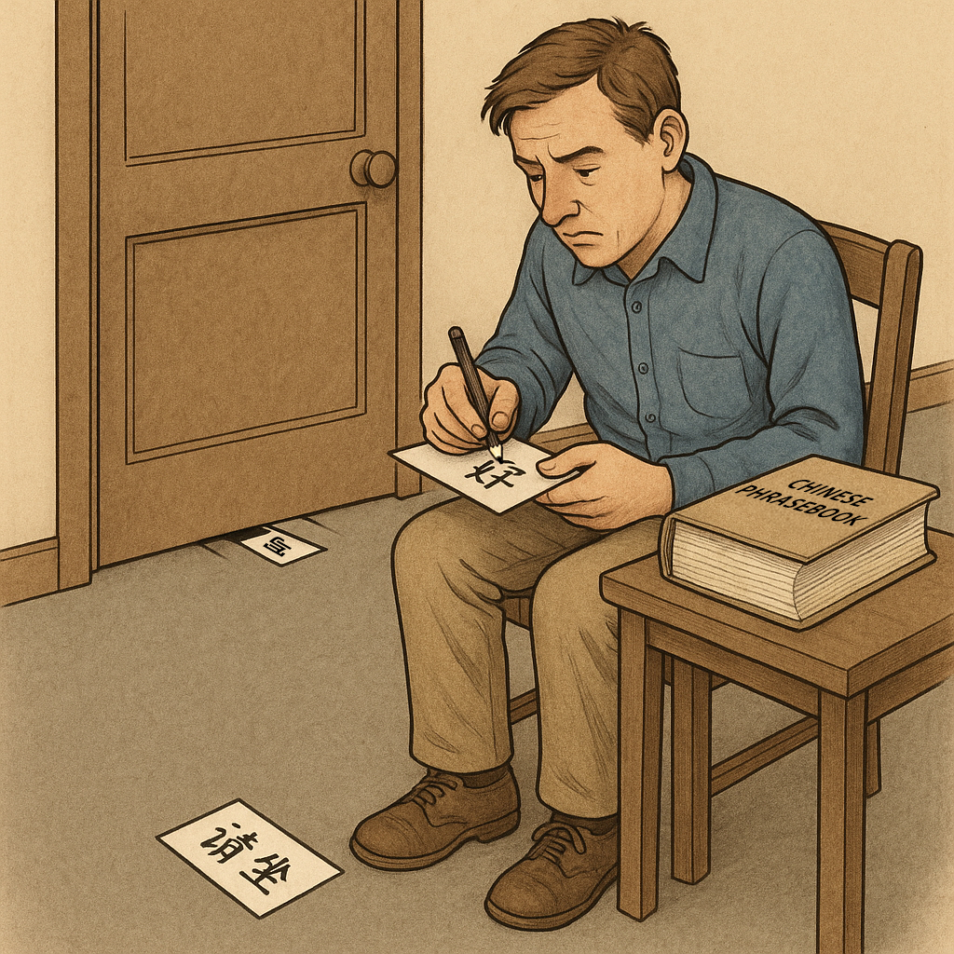
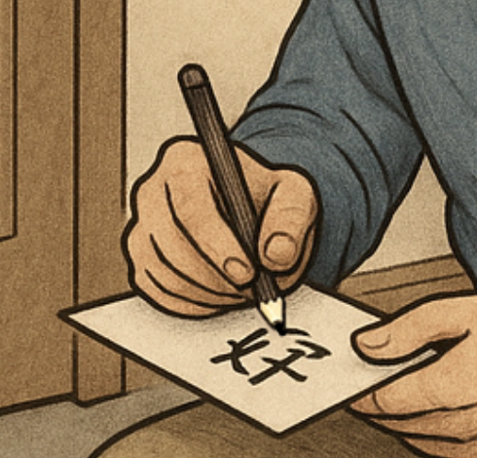

Chinese Room Argument (1980)
Image by ChatGPT for CDS DX 704…

Slide 19
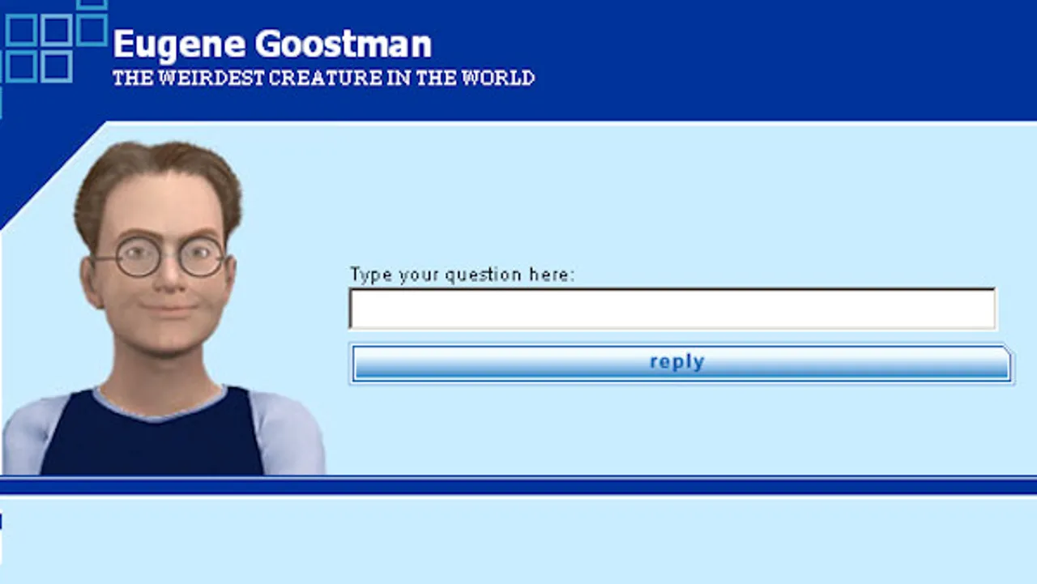
Eugene Goostman (2001)
Computer chatbot 'Eugene Goostman' passes the Turing test
“Some of Eugene Goostman's success is down to the choice of a 13-year-old boy from Odessa, who can't be expected to know everything and might be forgiven for minor grammatical or linguistic errors.”

Slide 20
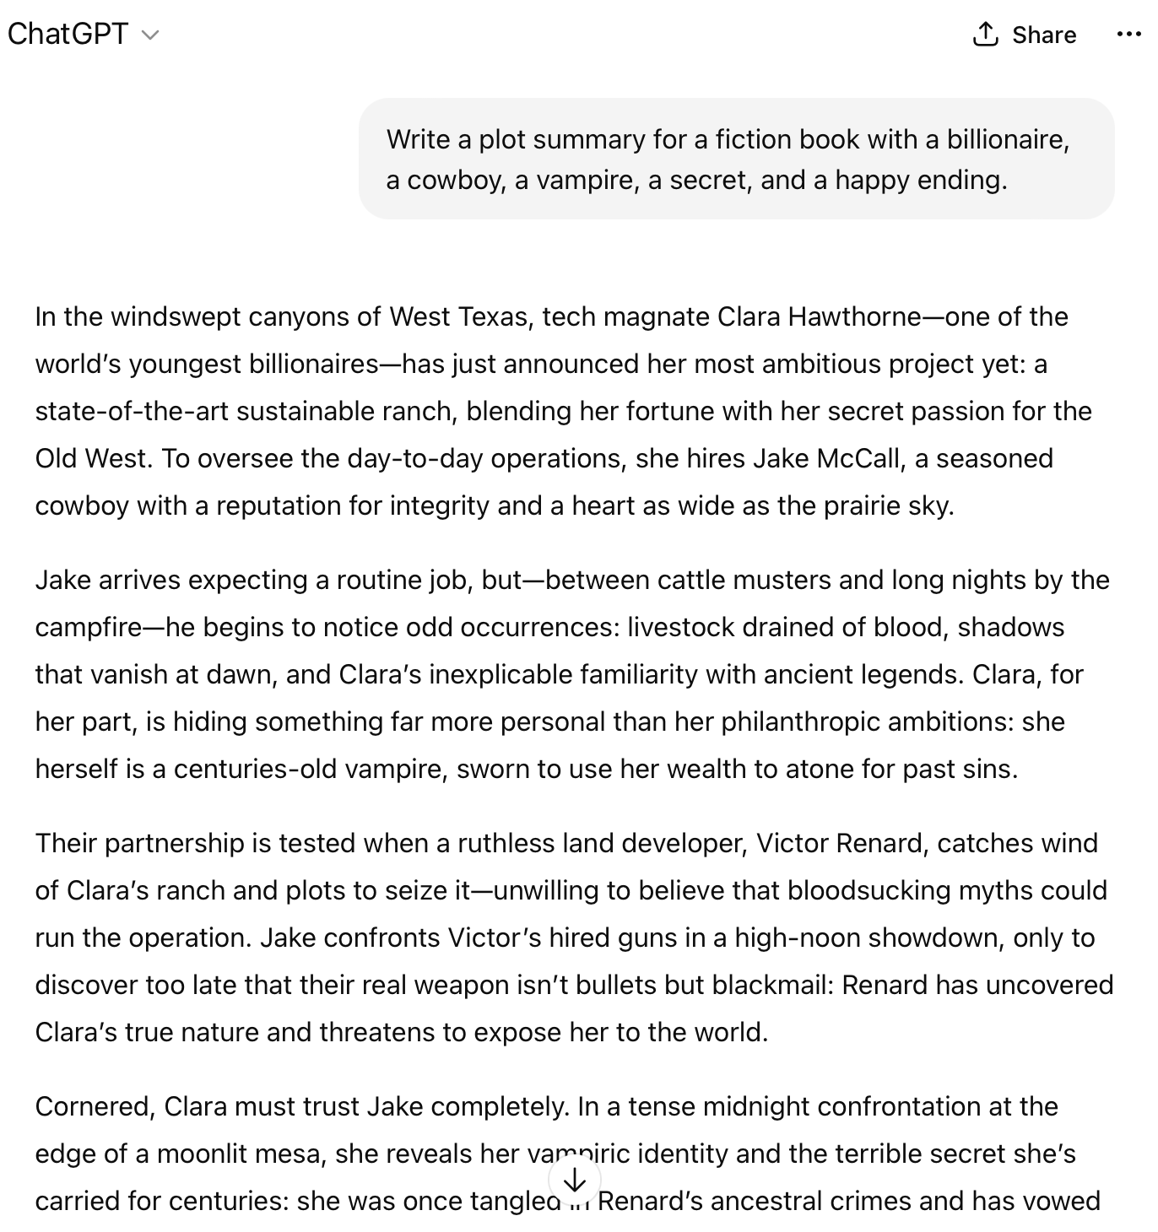
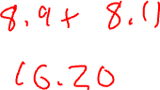
ChatGPT (2022)
https://chatgpt.com

Slide 21

What Makes a System Feel Intelligent to You?
???

Slide 22
Any questions?

Slide 23
AI Definition: Acting Humanly (Russel+Norvig)
A system is “intelligent” if it behaves indistinguishably from a human.

Slide 24
AI Definition: Thinking Humanly (Russel+Norvig)
Artificial intelligence seeks to model the actual cognitive processes of the human mind—i.e. to recreate how humans think, not just mimic their behavior.

Slide 25
AI Definition: Thinking Rationally (Russel+Norvig)
Intelligence is correct reasoning: AI is about implementing the formal laws of thought (logic, deduction) so a machine draws the "right" conclusions from its knowledge.

Slide 26
AI Definition: Acting Rationally (Russel+Norvig)
An intelligent agent is an entity or system that perceives its environment and takes actions to maximize its expected performance measure—whether or not it "thinks" like a human.

Slide 27
AI Definition: General / Popular Framing (Russel+Norvig)
AI is simply the branch of computer science concerned with building machines capable of tasks—learning, reasoning, perception, language—that normally require human intelligence.

Slide 28

Which Definition Makes Sense for Us?
Acting humanly
Thinking humanly
Thinking rationally
Acting rationally
General / popular framing

Slide 29
Any questions?

Slide 30

Artificial General Intelligence (AGI)
AI for anything?
Earliest known usage in 1997…
Nanotechnology and International Security
Got more popular around 2002…
Who coined the term “AGI”?
Definitions vary widely…

Slide 31
DeepMind Levels of AGI
Source: Levels of AGI for Operationalizing Progress on the Path to AGI (2024)
Level | Performance Criteria
Level 0: No AI
Level 1: Emerging | Equal to or somewhat better than an unskilled human
Level 2: Competent | At least 50th percentile of skilled adults
Level 3: Expert | At least 90th percentile of skilled adults
Level 4: Virtuoso | At least 99th percentile of skilled adults
Level 5: Superhuman | Outperforms 100% of humans

Slide 32
DeepMind Levels of AGI – Narrow Examples
Level | Narrow Examples
Level 0: No AI | Calculator software; compiler
Level 1: Emerging | GOFAI (Boden, 2014); simple rule-based systems, e.g., SHRDLU (Winograd, 1971)
Level 2: Competent | toxicity detectors such as Jigsaw (Das et al., 2022); Smart Speakers such as Siri (Apple), Alexa (Amazon), or Google Assistant (Google); VQA systems such as PaLI (Chen et al., 2023); Watson (IBM); SOTA LLMs for a subset of tasks (e.g., short essay writing, simple coding)
Level 3: Expert | spelling & grammar checkers such as Grammarly (Grammarly, 2023); generative image models such as Imagen (Saharia et al., 2022) or Dall-E 2 (Ramesh et al., 2022)
Level 4: Virtuoso | Deep Blue (Campbell et al., 2002), AlphaGo (Silver et al., 2016; 2017)
Level 5: Superhuman | AlphaFold (Jumper et al., 2021; Varadi et al., 2021), AlphaZero (Silver et al., 2018), StockFish (Stockfish, 2023)
Source: Levels of AGI for Operationalizing Progress on the Path to AGI (2024)

Slide 33
DeepMind Levels of AGI – General Examples
Level | General Examples
Level 0: No AI | human-in-the-loop computing, e.g., Ama- zon Mechanical Turk
Level 1: Emerging | ChatGPT (OpenAI, 2023), Bard (Anil et al., 2023), Llama 2 (Touvron et al., 2023), Gemini (Pichai & Hassabis, 2023)
Level 2: Competent | not yet achieved
Level 3: Expert | not yet achieved
Level 4: Virtuoso | not yet achieved
Level 5: Superhuman | not yet achieved
Source: Levels of AGI for Operationalizing Progress on the Path to AGI (2024)

Slide 34
What AI Successes have Impacted You?
???

Slide 35
Some More Examples
Optical character recognition
Speech recognition
Auto-captioning in YouTube
Roomba vacuum cleaners
Self-driving cars
Camera mouse

Slide 36
Any questions?

Slide 37
Course logistics
Lectures: Tuesday/Thursday
Discussions: Fridays
Hands on practice with topics from lecture.
Graded exercises each week.
Homework:
Assigned/due every week except around midterm.
Usually posted Tuesday, due next week Thursday.
2 days for late submission (-1% per hour)

Slide 38
Blackboard
https://learn.bu.edu
Links to everything for this class will be here.
Resources / extra readings are here.
They may come up in homework or exams.

Slide 39
Grading
Discussions: 12%
Homework: 48%
Midterm: 20%
Final: 20%

Slide 40
Course Staff
Instructor Jeffrey Considine (me)
Email: jconsidi@bu.edu
Office: CDS 1645
Office Hours:
Monday 11-12
Tuesday 3-4
Wednesday 1-2
Thursday 1-2
Teaching Fellow Mahir Patel
Email: mahirp@bu.edu
Office Hours Location: TBD
Office Hours: TBD

Slide 41
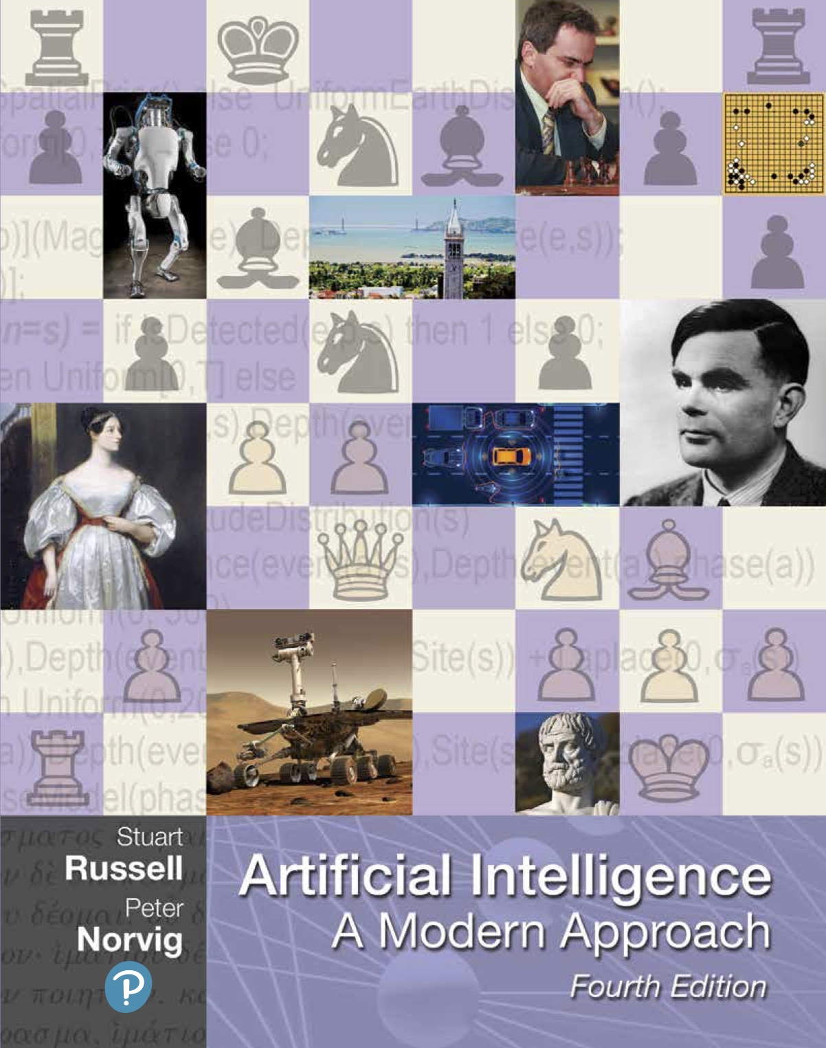
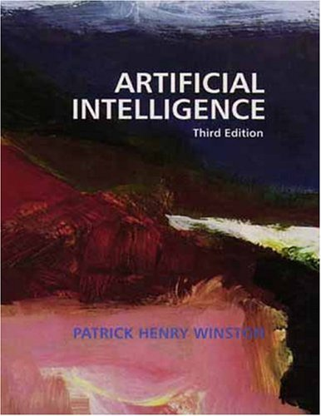
Textbooks – None Required But These Two are Good
Will post links to some of these chapters.
Winston made them publicly available.

